Slide 1



GPU Accelerated
Branch and Bound through
Best First Search
Samiran Kawtikwar*, Izzat Al Hajj†, Rakesh Nagi*‡
*
†
‡

Slide 2
Background
Our FRAMEWORK
Evaluation

Slide 3
Branch and Bound
Branch and bound is a method for solving optimization problems by breaking them down into smaller sub-problems and using a bounding function to eliminate sub-problems that cannot contain the optimal solution.
- Wikipedia
Key components of Branch and Bound [1]:
Bounding Function: Computes bounds to prune suboptimal regions.
Node Selection: Guides exploration order (Depth First, Breadth First, Best First..)
Branching rule: Guides where to split the problem into smaller subproblems.
[1] Land, A. H., & Doig, A. G. (1960). An Automatic Method of Solving Discrete Programming Problems. Econometrica, 28(3), 497–520.

Slide 4
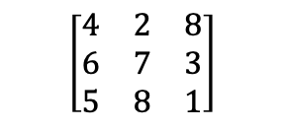
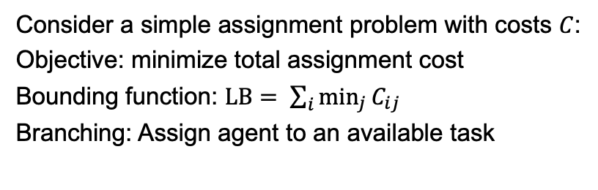

Branch and Bound -- Example
Tasks
Consider a simple assignment problem with costs $C$:
Objective: minimize total assignment cost
Bounding function: $LB= \sum_{i}{\min_{j}{C_{ij}}}$
Branching: Assign agent to an available task
$$\left[\begin{matrix}4 & 2 & 8 \\ 6 & 7 & 3 \\ 5 & 8 & 1\end{matrix}\right]$$
T1 | T2 | T3
Agents
LB
Node Selection: Depth First Search
UB = $∞$
x | x | x
6
A1 | x | x
8
A1 | A2 | x
12
A1 | A2 | A3
12

Slide 5

Branch and Bound -- Example
Tasks
Consider a simple assignment problem with costs $C$:
Objective: minimize total assignment cost
Bounding function: $LB= \sum_{i}{\min_{j}{C_{ij}}}$
Branching: Assign agent to an available task
$$\left[\begin{matrix}4 & 2 & 8 \\ 6 & 7 & 3 \\ 5 & 8 & 1\end{matrix}\right]$$
T1 | T2 | T3
Agents
LB
Node Selection: Depth First Search
UB = $12$
x | x | x
6
A1 | x | x
8
A1 | A2 | x
12
A1 | x | A2
15
Cannot be optimal
A1 | A2 | A3
12

Slide 6
Branch and Bound -- Example
Tasks
Consider a simple assignment problem with costs $C$:
Objective: minimize total assignment cost
Bounding function: $LB= \sum_{i}{\min_{j}{C_{ij}}}$
Branching: Assign agent to an available task
$$\left[\begin{matrix}4 & 2 & 8 \\ 6 & 7 & 3 \\ 5 & 8 & 1\end{matrix}\right]$$
T1 | T2 | T3
Agents
LB
Node Selection: Depth First Search
UB = $12$
x | x | x
6
A1 | x | x
8
x | A1 | x
6
12
15
A2 | A1 | x
9
12
A2 | A1 | A3
9

Slide 7

Branch and Bound -- Example
Tasks
Consider a simple assignment problem with costs $C$:
Objective: minimize total assignment cost
Bounding function: $LB= \sum_{i}{\min_{j}{C_{ij}}}$
Branching: Assign agent to an available task
$$\left[\begin{matrix}4 & 2 & 8 \\ 6 & 7 & 3 \\ 5 & 8 & 1\end{matrix}\right]$$
T1 | T2 | T3
Agents
LB
Node Selection: Depth First Search
UB = $9$
x | x | x
6
A1 | x | x
8
x | A1 | x
6
12
15
9
x | A1 | A2
6
12
9
A3 | A1 | A2
10
Better solution exists

Slide 8
Branch and Bound -- Example
Tasks
Consider a simple assignment problem with costs $C$:
Objective: minimize total assignment cost
Bounding function: $LB= \sum_{i}{\min_{j}{C_{ij}}}$
Branching: Assign agent to an available task
$$\left[\begin{matrix}4 & 2 & 8 \\ 6 & 7 & 3 \\ 5 & 8 & 1\end{matrix}\right]$$
T1 | T2 | T3
Agents
LB
Node Selection: Depth First Search
UB = $9$
x | x | x
6
A1 | x | x
8
x | A1 | x
6
x | x | A1
12
Cannot be optimal
12
15
9
6
12
A2 | A1 | A3
9
10
Optimal Solution

Slide 9


Branch and Bound -- Example
Tasks
Consider a simple assignment problem with costs $C$:
Objective: minimize total assignment cost
Bounding function: $LB= \sum_{i}{\min_{j}{C_{ij}}}$
Branching: Assign agent to an available task
$$\left[\begin{matrix}4 & 2 & 8 \\ 6 & 7 & 3 \\ 5 & 8 & 1\end{matrix}\right]$$
T1 | T2 | T3
Agents
LB
Node Selection: Depth First Search
Best First Search
UB = $9$
6
x | x | x
6
UB = $∞$
Best key = $6$
8
6
12
A1 | x | x
8
x | A1 | x
6
12
15
9
6
A2 | A1 | x
9
x | A1 | A2
6
12
A2 | A1 | A3
9
10
10
A3 | A1 | A2
Optimal Solution

Slide 10

Branch and Bound -- Example
Tasks
Consider a simple assignment problem with costs $C$:
Objective: minimize total assignment cost
Bounding function: $LB= \sum_{i}{\min_{j}{C_{ij}}}$
Branching: Assign agent to an available task
$$\left[\begin{matrix}4 & 2 & 8 \\ 6 & 7 & 3 \\ 5 & 8 & 1\end{matrix}\right]$$
T1 | T2 | T3
Agents
LB
Node Selection: Depth First Search
Best First Search
UB = $9$
6
x | x | x
6
UB = $10$
Best key = $6$
8
6
12
A1 | x | x
8
x | A1 | x
6
x | x | A1
12
12
15
9
6
A2 | A1 | x
9
x | A1 | A2
6
12
A2 | A1 | A3
9
10
10
A3 | A1 | A2
Optimal Solution

Slide 11
Branch and Bound -- Example
Tasks
Consider a simple assignment problem with costs $C$:
Objective: minimize total assignment cost
Bounding function: $LB= \sum_{i}{\min_{j}{C_{ij}}}$
Branching: Assign agent to an available task
$$\left[\begin{matrix}4 & 2 & 8 \\ 6 & 7 & 3 \\ 5 & 8 & 1\end{matrix}\right]$$
T1 | T2 | T3
Agents
LB
Node Selection: Depth First Search
Best First Search
UB = $9$
6
x | x | x
6
UB = $10$
Best key = 8
8
6
12
A1 | x | x
8
x | A1 | x
6
x | x | A1
12
12
15
9
6
A1 | A2 | x
12
A1 | x | A2
15
9
6
10
12
A2 | A1 | A3
9
10
Optimal Solution

Slide 12
Branch and Bound -- Example
Tasks
Consider a simple assignment problem with costs $C$:
Objective: minimize total assignment cost
Bounding function: $LB= \sum_{i}{\min_{j}{C_{ij}}}$
Branching: Assign agent to an available task
$$\left[\begin{matrix}4 & 2 & 8 \\ 6 & 7 & 3 \\ 5 & 8 & 1\end{matrix}\right]$$
T1 | T2 | T3
Agents
LB
Node Selection: Depth First Search
Best First Search
UB = $9$
6
x | x | x
6
UB = $10$
Best key = 9
8
6
12
A1 | x | x
8
x | A1 | x
6
x | x | A1
12
12
15
9
6
12
15
9
6
9
10
12
A2 | A1 | A3
9
10
A2 | A1 | A3
Optimal Solution

Slide 13

Branch and Bound -- Example
Tasks
Consider a simple assignment problem with costs $C$:
Objective: minimize total assignment cost
Bounding function: $LB= \sum_{i}{\min_{j}{C_{ij}}}$
Branching: Assign agent to an available task
$$\left[\begin{matrix}4 & 2 & 8 \\ 6 & 7 & 3 \\ 5 & 8 & 1\end{matrix}\right]$$
T1 | T2 | T3
Agents
LB
Node Selection: Depth First Search
Best First Search
UB = $9$
6
x | x | x
6
UB = $9$
Best key = 10
8
6
12
A1 | x | x
8
x | A1 | x
6
x | x | A1
12
12
15
9
6
12
15
9
6
9
10
12
A2 | A1 | A3
9
10
A2 | A1 | A3
Optimal Solution
Optimal Solution

Slide 14
Branch and Bound -- Example
Tasks
Consider a simple assignment problem with costs $C$:
Objective: minimize total assignment cost
Bounding function: $LB= \sum_{i}{\min_{j}{C_{ij}}}$
Branching: Assign agent to an available task
$$\left[\begin{matrix}4 & 2 & 8 \\ 6 & 7 & 3 \\ 5 & 8 & 1\end{matrix}\right]$$
T1 | T2 | T3
Agents
LB
Node Selection: Depth First Search
Best First Search
UB = $9$
6
6
UB = $9$
Best key = 10
Nodes Explored – 11
Nodes Pruned – 4
8
6
12
8
6
12
12
12
15
9
6
Nodes Explored – 10
Nodes Pruned - 3
15
9
6
9
10
A2 | A1 | A3
9
10
12
A2 | A1 | A3
Optimal Solution
Optimal Solution

Slide 15
Branch and Bound -- Example
Tasks
Consider a simple assignment problem with costs $C$:
Objective: minimize total assignment cost
Bounding function: $LB= \sum_{i}{\min_{j}{C_{ij}}}$
Branching: Assign agent to an available task
$$\left[\begin{matrix}4 & 2 & 8 \\ 6 & 7 & 3 \\ 5 & 8 & 1\end{matrix}\right]$$
T1 | T2 | T3
Agents
LB
Node Selection: Depth First Search
Best First Search
UB = $9$
6
Trivial to Parallelize
6
Not Trivial to Parallelize
UB = $9$
1
6
2
Best key = 10
Nodes Explored – 11
Nodes Pruned – 4
8
6
12
8
3
6
12
7
4
8
12
12
15
9
6
Nodes Explored – 10
Nodes Pruned - 3
15
9
6
9
5
9
10
A2 | A1 | A3
9
10
12
A2 | A1 | A3
Optimal Solution
Optimal Solution

Slide 16
Node Selection - Example
Tasks
Consider a simple assignment problem with costs $C$:
Objective: minimize total assignment cost
Bounding function: $LB= \sum_{i}{\min_{j}{C_{ij}}}$
Branching: Assign agent to an available task
$$\left[\begin{matrix}4 & 2 & 8 \\ 6 & 7 & 3 \\ 5 & 8 & 1\end{matrix}\right]$$
T1 | T2 | T3
Agents
LB
Node Selection: Depth First Search
Best First Search
UB = $9$
6
6
UB = $9$
Best key = 10
Nodes Explored – 11
Nodes Pruned – 4
8
6
12
8
6
12
12
12
15
9
6
Nodes Explored – 10
Nodes Pruned - 3
15
9
6
9
10
A2 | A1 | A3
9
10
12
A2 | A1 | A3
Optimal Solution
Optimal Solution

Slide 17
Branch and Bound -- Example
Tasks
Consider a simple assignment problem with costs $C$:
Objective: minimize total assignment cost
Bounding function: $LB= \sum_{i}{\min_{j}{C_{ij}}}$
Branching: Assign agent to an available task
$$\left[\begin{matrix}4 & 2 & 8 \\ 6 & 7 & 3 \\ 5 & 8 & 1\end{matrix}\right]$$
T1 | T2 | T3
Agents
LB
Node Selection: Depth First Search
Best First Search
UB = $9$
6
Trivial to Parallelize*
6
Not Trivial to Parallelize
UB = $9$
1
6
2
Best key = 10
Nodes Explored – 11
Nodes Pruned – 4
8
6
12
8
3
6
12
7
4
8
12
12
15
9
6
Nodes Explored – 10
Nodes Pruned - 3
15
9
6
9
5
9
10
A2 | A1 | A3
9
10
12
A2 | A1 | A3
Optimal Solution
Optimal Solution

Slide 18
Prominence of Best First Search (BeFS)
Generally known to explore fewer nodes for most problems [1]
  Constructs the minimal tree (under certain conditions)
Focuses on improving lower bound (for minimization)
Most general commercial optimizers use BeFS (in tandem with DFS) [2,3]
Gives good quality worst-case optimality gap in given time
[1] J. T. Linderoth and M. W. P. Savelsbergh, "A Computational Study of Search Strategies for Mixed Integer Programming," INFORMS Journal on Computing, vol. 11, no. 2, pp. 173-187, 1999
[2] Sabharwal, A., Samulowitz, H., Reddy, C. (2012). Guiding Combinatorial Optimization with UCT. In: Beldiceanu, N., Jussien, N., Pinson, É. (eds) Integration of AI and OR Techniques in Contraint Programming for Combinatorial Optimzation Problems. CPAIOR 2012.
[3] Bertrand Neveu, Gilles Trombettoni, Ignacio Araya. Node selection strategies in interval Branch and Bound algorithms. Journal of Global Optimization, 2016

Slide 19
Parallelization in Branch-and-Bound
Tree search appears to be highly parallelizable – though trivial parallelization does not yield good performance, especially in discrete optimization [1]
  Highly unbalanced tree shape
  Order of node exploration matters (May not control in parallel environment)
  Information from one part of search maybe useful to other
Two classic approaches to parallelize B&B search [2]:
  Node based – Parallelize bound calculations, evaluate all children in parallel
  Tree based – Build and explore the B&B tree in parallel
[1] Ted Ralphs, Yuji Shinano, Timo Berthold, and Thorsten Koch. 2018. Parallel Solvers for Mixed Integer Linear Optimization. In Handbook of Parallel Constraint Reasoning, Youssef Hamadi and Lakhdar Sais (eds.). Springer International Publishing, Cham, 283–336.
[2] Crainic, T.G., Le Cun, B. and Roucairol, C. (2006). Parallel Branch-and-Bound Algorithms. In Parallel Combinatorial Optimization (eds A.Y. Zomaya and E.-G. Talbi).

Slide 20
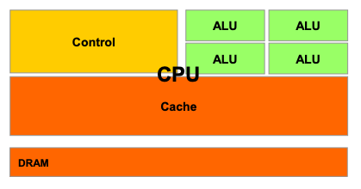
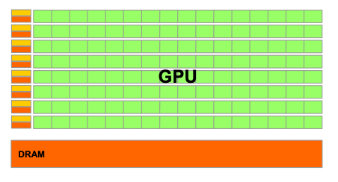
GPU Acceleration in Branch and Bound
CPUs ~ 100 parallel threads VS GPUs ~ 100K parallel threads
GPUs threads are SIMD (Single Instruction Multiple Data)
Node parallelism is inevitable – Active research area
Tree parallelism – Limited to DFS/BFS (No BeFS)

Slide 21
Parallelization in Branch-and-Bound - Literature Gap
Node based
Parallel LP solvers
Parallel dual revised simplex [1]
Parallel interior point [2]
PDLP [3, 4]
Bounding Methods
Parallel Dual ascent for MAP – [5]
Johnson’s algorithm for FSP – [8]
Polytomic Branching – [6]
Decomposition based Methods [7]
Tree based
Parallel BFS/DFS implementations
DFS based graph search [9]
Master – Worker frameworks [10]
Master – Hub – Worker frameworks [11, 12]
Collegial frameworks [13]
Both CPU and GPU parallelization
This work
CPU parallelization only
CPU GPU
Notes:
[1] Huangfu, Q., Hall, J.A.J. Parallelizing the dual revised simplex method. Math. Prog. Comp. 10, 119–142 (2018).
[2] Gondzio, J., Sarkissian, R. Parallel interior-point solver for structured linear programs. Math. Program., Ser. A 96, 561–584 (2003)
[3] D. Applegate, M. Díaz, H. Lu, and M. Lubin, "Infeasibility Detection with Primal-Dual Hybrid Gradient for Large-Scale Linear Programming," SIAM Journal on Optimization, vol. 34, no. 1, pp. 459-484, Jan. 2024.
[4] https://developer.nvidia.com/blog/accelerate-large-linear-programming-problems-with-nvidia-cuopt/
[5] S. Vadrevu and R. Nagi, "A GPU Accelerated Dual-Ascent Algorithm for the Multidimensional Assignment Problem in a Multitarget Tracking Application," in IEEE Transactions on Automation Science and Engineering, vol. 20, no. 3, pp. 1706-1720, July 2023
[6] K. Date and R. Nagi, "Level 2 Reformulation Linearization Technique–Based Parallel Algorithms for Solving Large Quadratic Assignment Problems on Graphics Processing Unit Clusters," INFORMS Journal on Computing, vol. 31, no. 4, pp. 771-789, Oct. 2019
[7] Mateo, J., Plà, L.M., Solsona, F. et al. A scalable parallel implementation of the Cluster Benders Decomposition algorithm. Cluster Comput 22, 877–886 (2019)
[8] N. Melab, I. Chakroun, M. Mezmaz and D. Tuyttens, "A GPU-accelerated Branch-and-Bound Algorithm for the Flow-Shop Scheduling Problem," 2012 IEEE International Conference on Cluster Computing, Beijing, China, 2012.
[9] Samiran Kawtikwar, Mohammad Almasri, Wen-Mei Hwu, Rakesh Nagi, and Jinjun Xiong. 2023. BEEP: Balanced Efficient subgraph Enumeration in Parallel. In Proceedings of the 52nd International Conference on Parallel Processing (ICPP '23).
[10] Shinano, Y., Heinz, S., Vigerske, S., Winkler, M.: FiberSCIP – a shared memory parallelization of SCIP. INFORMS Journal on Computing, Published online 2017
[11] Eckstein, J., Hart, W.E., Phillips, C.A.: PEBBL: an object-oriented framework for scalable parallel branch and bound. Mathematical Programming Computation 7(4), 429–469 (2015)
[12] yanxu55, Ted Ralphs, & Stefan Vigerske. (2017). coin-or/CHiPPS-ALPS: Version 1.5.6 (releases/1.5.6). Zenodo.
[13] Lluís-Miquel Munguía, Geoffrey Oxberry, Deepak Rajan, and Yuji Shinano. 2019. Parallel PIPS-SBB: multi-level parallelism for stochastic mixed-integer programs. Comput. Optim. Appl. 73, 2 (June 2019)

Slide 22
Background
OUR FRAMEWORK
Evaluation

Slide 23
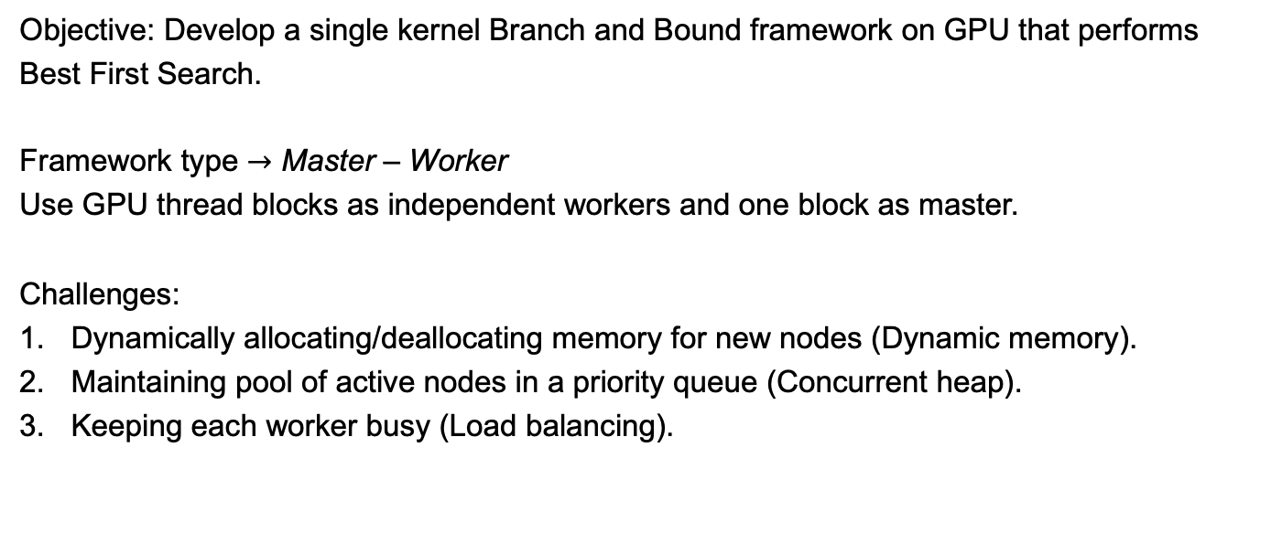
Branch-and-bound framework on GPU - Challenges
Objective: Develop a single kernel Branch and Bound framework on GPU that performs Best First Search.
Framework type $→$ Master – Worker
Use GPU thread blocks as independent workers and one block as master.
Challenges:
Dynamically allocating/deallocating memory for new nodes (Dynamic memory).
Maintaining pool of active nodes in a priority queue (Concurrent heap).
Keeping each worker busy (Load balancing).

Slide 24
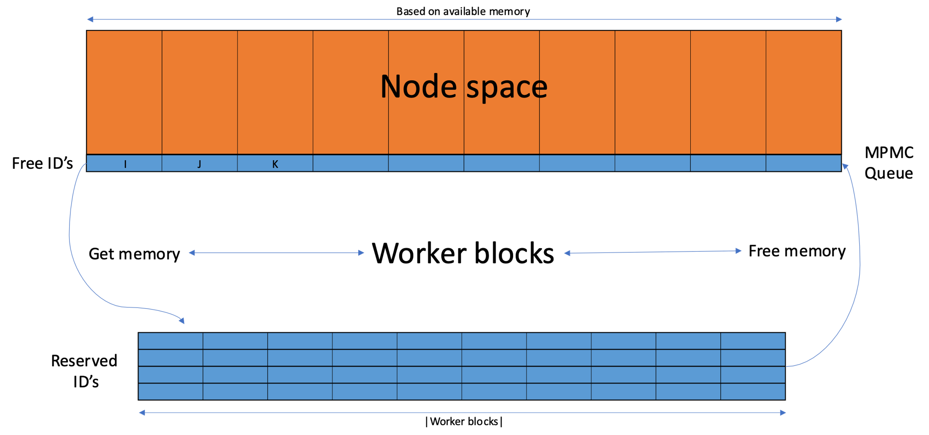
Challenge #1 Dynamic Memory
Objective – Want equivalent of malloc and free within a GPU kernel
Solution – Memory manager with MPMC queue
- Reserve some VRAM memory (node space).
- Store index for each memory chunk in a concurrent queue.
- Workers dequeue and enqueue on the queue to get/give memory chunk indexes

Slide 25

Challenge #2 Concurrent Heap
Objective – Want a shared heap for all GPU workers to pop best node at each time
Solution – Request manager with MPSC queue
  Workers $−>$ Explore Nodes
  Master $−>$ Manage Heap

Slide 26






Challenge #3 Load balancing
Challenge : Keep every worker busy
Branch
Update Bounds
BnB check (I.I.I.)
$$LB$$
Memory
Manager
Request
Manager
 |  |  |  |  |  | .....
Priority Queue
Master
$$LB_{1}^{new}$$
$$LB_{2}^{new}$$
$$LB_{3}^{new}$$
$$LB_{4}^{new}$$
$$LB_{5}^{new}$$
Each Worker
Workers stay busy as long as no wait for push/pop
...
Push
Pop
Update Bounds
Push
Pop
...
Time

Slide 27
Features
Combining the solutions used to address the 3 challenges give a GPU resident BnB framework.
To solve a discrete optimization problem user needs to specify:
Features to save for a node
Bounding method [that uses a thread block]
Branching method
The framework takes care of managing the nodes and the search order.
Let’s test the framework performance.

Slide 28
Background
Our FRAMEWORK
Evaluation

Slide 29


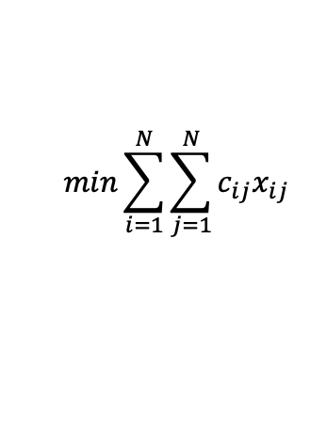
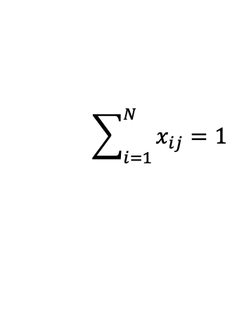
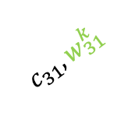

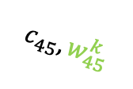




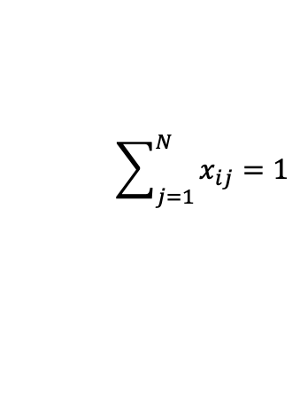
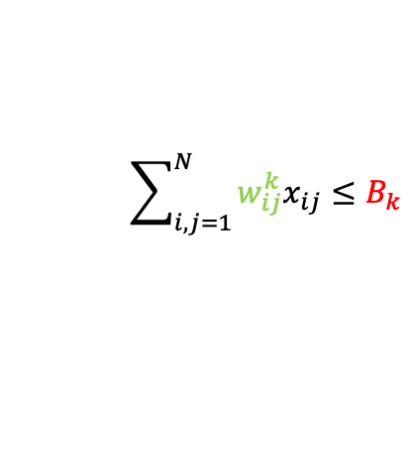
Testing BnB framework with RCAP
RCAP – Resource Constrained Assignment Problem
$$min\sum_{i=1}^{N}{\sum_{j=1}^{N}{c_{ij}x_{ij}}}$$
$$c_{11}, w_{11}^{k}$$
1
1
$$c_{31}, w_{31}^{k}$$
2
2
$$\sum_{j=1}^{N}{x_{ij}}=1$$
$$∀i∈\{1,2,…,N\}$$
3
3
$$\sum_{i=1}^{N}{x_{ij}}=1$$
$$∀j∈\{1,2,…,N\}$$
4
$$c_{45}, w_{45}^{k}$$
4
$$\sum_{i,j=1}^{N}{w_{ij}^{k}x_{ij}}≤B_{k}$$
Resource constraints
$$∀k∈\{1,2,…,K\}$$
5
5
$x_{ij}∈\left\{0,1\right\}$ $∀i,j∈\{1,2,…,N\}$

Slide 30

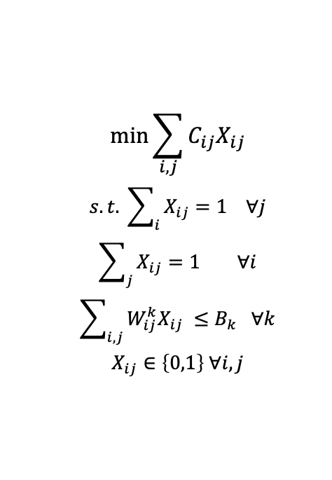
Bounds for RCAP
$$\min{\sum_{i,j}{C_{ij}X_{ij}}}$$
$$s.t. \sum_{i}{X_{ij}}=1 ∀j$$
$$\sum_{j}{X_{ij}}=1 ∀i$$
$$\sum_{i,j}{W_{ij}^{k}X_{ij}} ≤B_{k} ∀k$$
$$X_{ij}∈\left\{0,1\right\} ∀i,j$$
$$\min{\sum_{i,j}{C_{ij}X_{ij}}}+\sum_{i,j,k}{u_{k}(W_{ij}^{k}X_{ij}−B_{k})}$$
$$s.t. \sum_{i}{X_{ij}}=1 ∀j$$
$$\sum_{j}{X_{ij}}=1 ∀i$$
$$X_{ij}∈\left\{0,1\right\} ∀i,j$$
$$u_{k}≥0 ∀k$$
LR - RCAP
RCAP
Relaxed problem is LAP (GPU solver available)
Use multiplier update procedure [Fisher et al.]

Slide 31
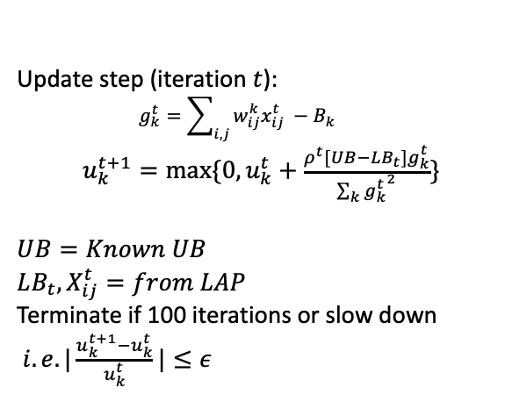
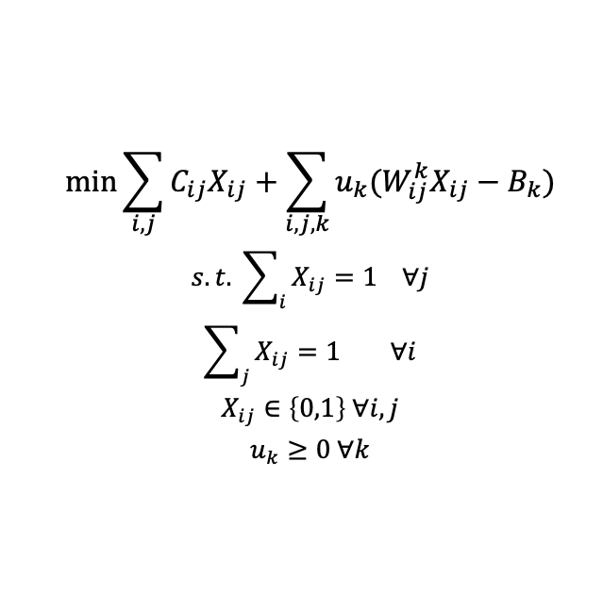
Bounds for RCAP
$$\min{\sum_{i,j}{C_{ij}X_{ij}}}+\sum_{i,j,k}{u_{k}(W_{ij}^{k}X_{ij}−B_{k})}$$
$$s.t. \sum_{i}{X_{ij}}=1 ∀j$$
$$\sum_{j}{X_{ij}}=1 ∀i$$
$$X_{ij}∈\left\{0,1\right\} ∀i,j$$
$$u_{k}≥0 ∀k$$
Update step (iteration $t$):
$$g_{k}^{t}=\sum_{i,j}{w_{ij}^{k}x_{ij}^{t}} −B_{k}$$
$u_{k}^{t+1}=max⁡\{0, u_{k}^{t}+\frac{ρ^{t}[UB−LB_{t}]g_{k}^{t}}{\sum_{k}{{g_{k}^{t}}^{2}}}\}$
$$UB=Known UB$$
$$LB_{t}, X_{ij}^{t}=from LAP$$
Terminate if 100 iterations or slow down
$i.e. |\frac{u_{k}^{t+1}−u_{k}^{t}}{u_{k}^{t}}|≤ε$
Use full thread block to solve LAP using HyLAC [Kawtikwar and Nagi]
LR - RCAP
How does the framework perform with this bounding method?
Relaxed problem is LAP (GPU solver available)
Use multiplier update procedure [Fisher et al.]
Notes:
[1] Fisher, Marshall L. “The Lagrangian Relaxation Method for Solving Integer Programming Problems.” Management Science, vol. 50, no. 12, 2004,
[2] Kawtikwar, Samiran, and Rakesh Nagi. “HyLAC: Hybrid Linear Assignment Solver in CUDA.” Journal of Parallel and Distributed Computing, vol. 187, May 2024.

Slide 32
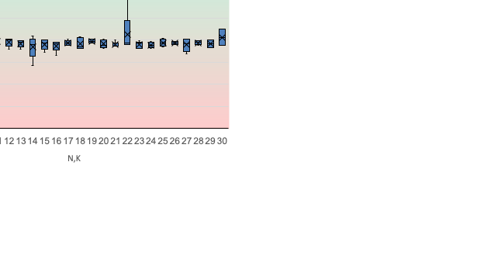
Results #1 closeness to strict BeFS
How the parallel framework mimics the “ideal” single threaded Best First Search?
N,K | Nodes (Sequential) Explored + pruned | Nodes (Parallel) Explored + pruned | Ratio Sequential/parallel
10 | 2158 | 2131 | 1.0127
15 | 13857 | 14194 | 0.9763
16 | 131708 | 134541 | 0.9789
17 | 11499 | 11439 | 1.0052
18 | 16091 | 15900 | 1.0120
19 | 102597 | 103943 | 0.9871
20 | 183811 | 190724 | 0.9638
21 | 17269 | 17739 | 0.9735
22 | 101191 | 102424 | 0.9880
23 | 201525 | 209146 | 0.9636
24 | 700939 | 706064 | 0.9927
25 | 312597 | 316903 | 0.9864
26 | 3346564 | 3368934 | 0.9934
27 | 48247 | 51340 | 0.9398
28 | 4500106 | 4537385 | 0.9918
29 | 9079168 | 9078687 | 1.0001
30 | 6490320 | 6647589 | 0.9763

Slide 33
Results #2 Performance analysis
See if the master is bottlenecking the workers
See if the kernel is giving good compute performance
Runtime
> 20 sec
No underflow,
no waiting
|workers| = 3455
1 - 20 sec
~60% compute
throughput
< 1 sec

Slide 34
Results #3 Comparison with CPU baseline
Comparison with single threaded CPU (Same LB strategy)
Hardware spec:
AMD Milan CPU with
256 GB RAM
NVIDIA A100 with 80GB HBM2e

Slide 35
Conclusions
#1 Cost of parallelism is insignificant:
# of additional nodes explored < 10%
#2 Master doesn’t bottleneck
Workers spend >98% time in bound updates
Framework allows use of other node selection strategies
#3 ~ 400x speedup for large instances
Guaranteed to beat the most ideal CPU BnB frameworks that use Best First Search
Node and tree parallelism both contribute to speedup
Still long way from commercial MILP solvers
~ 10x slower than Gurobi (Need tighter, faster bounds; cut generation etc.)

Slide 36
Future work
Framework level:
  Scale to multiple GPUs (A master hub worker framework)
  Integrate with diving strategies to improve Upper Bounds
Node level:
Need LP solvers with block level parallelism to get quicker and better bounds
Need parallel dynamic solvers for quick resolve

Slide 37
References
[1] Huangfu, Q., Hall, J.A.J. Parallelizing the dual revised simplex method. Math. Prog. Comp. 10, 119–142 (2018).
[2] Gondzio, J., Sarkissian, R. Parallel interior-point solver for structured linear programs. Math. Program., Ser. A 96, 561–584 (2003)
[3] D. Applegate, M. Díaz, H. Lu, and M. Lubin, "Infeasibility Detection with Primal-Dual Hybrid Gradient for Large-Scale Linear Programming," SIAM Journal on Optimization, vol. 34, no. 1, pp. 459-484, Jan. 2024.
[4] https://developer.nvidia.com/blog/accelerate-large-linear-programming-problems-with-nvidia-cuopt/
[5] S. Vadrevu and R. Nagi, "A GPU Accelerated Dual-Ascent Algorithm for the Multidimensional Assignment Problem in a Multitarget Tracking Application," in IEEE Transactions on Automation Science and Engineering, vol. 20, no. 3, pp. 1706-1720, July 2023
[6] K. Date and R. Nagi, "Level 2 Reformulation Linearization Technique–Based Parallel Algorithms for Solving Large Quadratic Assignment Problems on Graphics Processing Unit Clusters," INFORMS Journal on Computing, vol. 31, no. 4, pp. 771-789, Oct. 2019
[7] Mateo, J., Plà, L.M., Solsona, F. et al. A scalable parallel implementation of the Cluster Benders Decomposition algorithm. Cluster Comput 22, 877–886 (2019)
[8] N. Melab, I. Chakroun, M. Mezmaz and D. Tuyttens, "A GPU-accelerated Branch-and-Bound Algorithm for the Flow-Shop Scheduling Problem," 2012 IEEE International Conference on Cluster Computing, Beijing, China, 2012.
[9] Samiran Kawtikwar, Mohammad Almasri, Wen-Mei Hwu, Rakesh Nagi, and Jinjun Xiong. 2023. BEEP: Balanced Efficient subgraph Enumeration in Parallel. In Proceedings of the 52nd International Conference on Parallel Processing (ICPP '23).
[10] Shinano, Y., Heinz, S., Vigerske, S., Winkler, M.: FiberSCIP – a shared memory parallelization of SCIP. INFORMS Journal on Computing, Published online 2017
[11] Eckstein, J., Hart, W.E., Phillips, C.A.: PEBBL: an object-oriented framework for scalable parallel branch and bound. Mathematical Programming Computation 7(4), 429–469 (2015)
[12] yanxu55, Ted Ralphs, & Stefan Vigerske. (2017). coin-or/CHiPPS-ALPS: Version 1.5.6 (releases/1.5.6). Zenodo.
[13] Lluís-Miquel Munguía, Geoffrey Oxberry, Deepak Rajan, and Yuji Shinano. 2019. Parallel PIPS-SBB: multi-level parallelism for stochastic mixed-integer programs. Comput. Optim. Appl. 73, 2 (June 2019)

Slide 38

Thank you
Questions..
slides deck available at
samiran-kawtikwar.github.io
samiran2@illinois.edu

