Slide 1




GPU-Accelerated Crossover Inspired by Spiral Dynamics of PDHG
Samiran Kawtikwar*, Rakesh Nagi*†
*
†

Slide 2

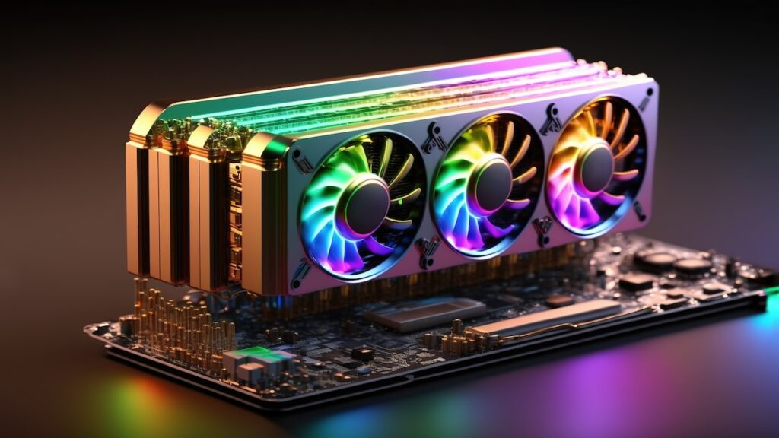
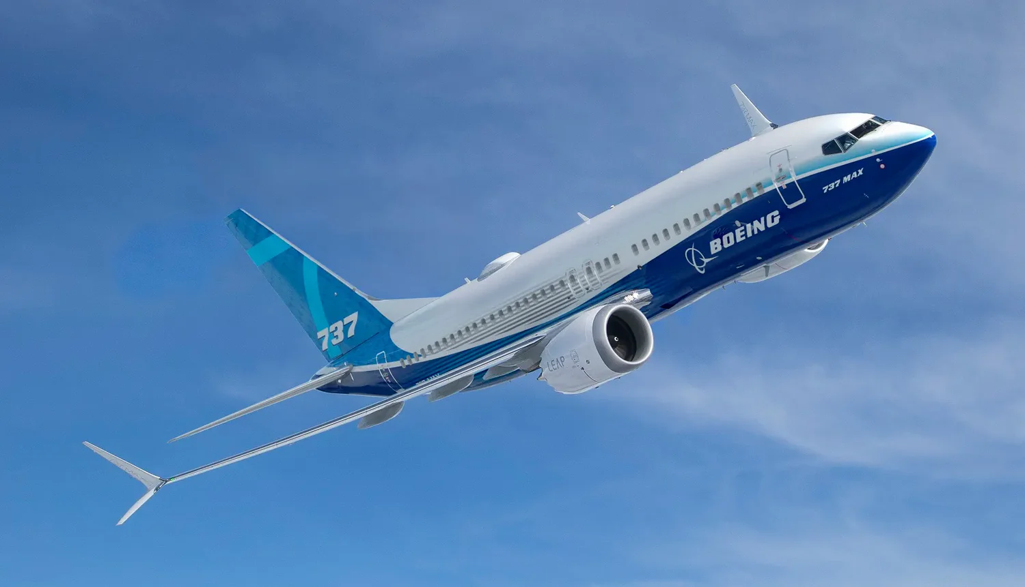
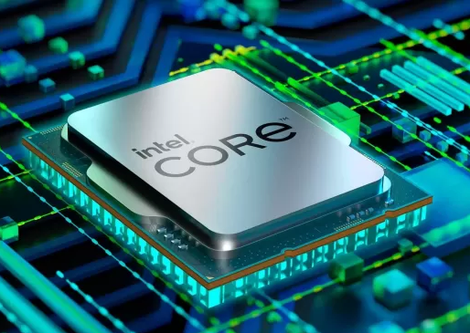
Introduction to GPUs
The tread off between Time (Latency) and Capacity (Bandwidth)
Ideal
Compute Bandwidth
Cargo Capacity
Time
Latency
GPUs are the cargo ships of modern processing
Notes:
We all know GPUs today as the engines behind gaming, deep learning, and now large language models. But to appreciate why they excel at these workloads, it helps to think in terms of a familiar trade-off: speed versus capacity.
In transportation, we’ve long balanced this trade-off. Airplanes move fast but carry little, while cargo ships are slow but move massive loads efficiently.
Something similar happened in computing. CPUs were designed for speed and responsiveness — handling a few tasks extremely quickly. But as data sizes and workloads grew, we needed a way to process many tasks at once rather than just one very fast. That’s where GPUs came in. They’re optimized for throughput — performing thousands of lightweight operations in parallel — even if each one takes a bit longer individually.
This shift proved transformative for gaming and later for AI, where the workloads naturally involve parallel operations.
So, in a way, GPUs are the cargo ships of modern processing — not built for quick delivery of a single packet, but for moving vast computational loads efficiently.

Slide 3
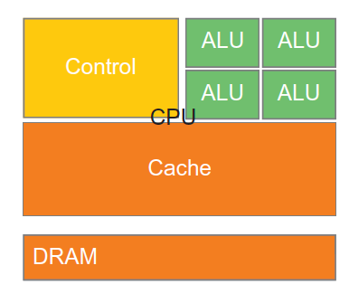
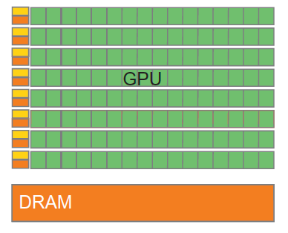
CPU vs GPU
Latency Optimized
Throughput Optimized
Large cache pools
Small cache/core
Control dominates
Compute dominates
Hundreds of cores
Thousands of cores
High Clock Speed
Low Clock Speed
Key performance differentiator:
Single Instruction Multi Data (SIMD) parallelism with HBM
“GPUs sacrifice some flexibility for massive parallel efficiency.”
Notes:
CPUs are optimized for latency: fewer, powerful cores with large caches.
GPUs, on the other hand, are optimized for throughput, with thousands of simpler cores working together.
The key to developing such compute hardware is SIMD parallelism where the same instruction is executed across many data points.
This is what makes GPUs ideal for matrix operations, image processing, and deep learning tasks.
So, in a nutshell we can say that “GPUs sacrifice some flexibility for massive parallel efficiency”

Slide 4
Using GPUs for Optimization is Inevitable
Hardware Compute Mix
Optimization community utilizing GPUs
99%
98%
99%
85%
2%
89%
1%
15%
100%
11%
1%
CPU and GPU compute resources in world’s best supercomputers*
# of times “GPU” was mentioned in abstracts at INFORMS annual meetings
Source: https://top500.org/
*Ignoring ARM architecture
HPC systems ramping up heavily on GPUs
Optimization will be unable to keep up with growing demand if relied only on CPUs

Slide 5
Motivation
Branch and Bound tree for MILP is usually represented as:
Branch and Bound tree for MILP practically looks like
Solve root LP relaxation
Root node LP-relaxation solution takes long time
Solving large scale LPs is hard particularly for MILPs

Slide 6
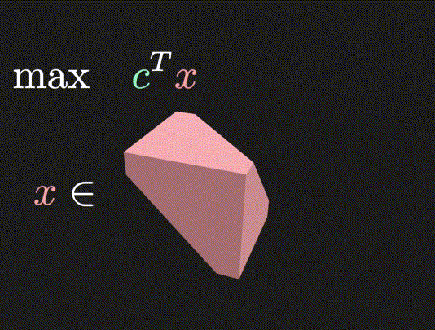
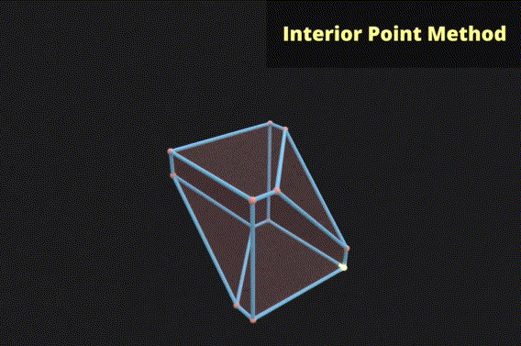
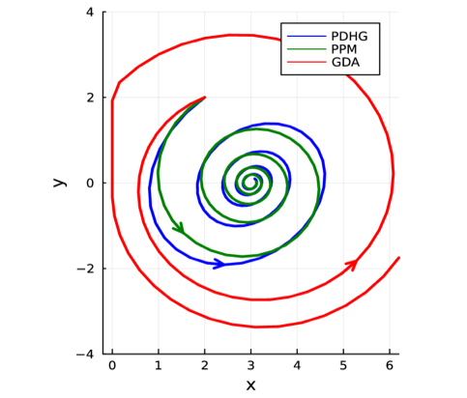
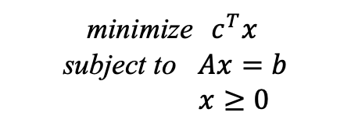
Solutions to Linear Programming
Linear Programming (LP) is polynomial time solvable
minimize $c^{T}x$
subject to $Ax=b$
$x≥0$
Algorithms for LP can be categorized into:
Simplex
Interior Point
First-order
Source: Visually Explained
Source: Haihao Lu, FOM for LP (2024)

Slide 7
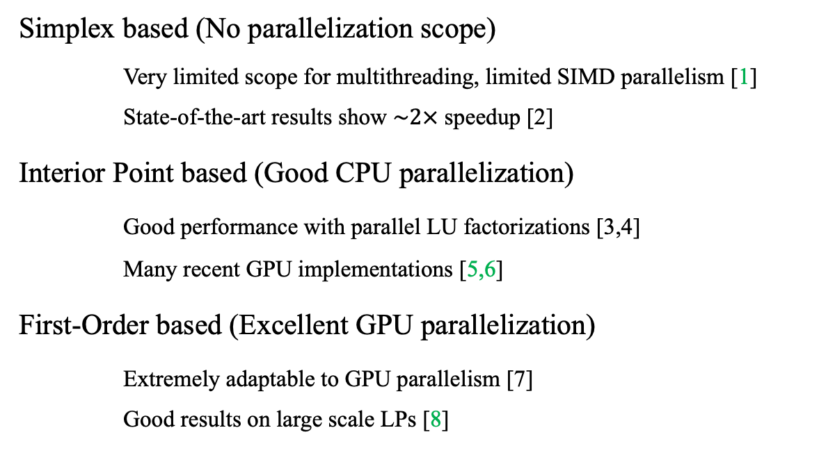
Parallelizability of LP algorithms
CPU, GPU
Simplex based (No parallelization scope)
Very limited scope for multithreading, limited SIMD parallelism [1]
State-of-the-art results show $\sim 2×$ speedup [2]
Interior Point based (Good CPU parallelization)
Good performance with parallel LU factorizations [3,4]
Many recent GPU implementations [5,6]
First-Order based (Excellent GPU parallelization)
Extremely adaptable to GPU parallelism [7]
Good results on large scale LPs [8]
Corner solutions
(Optimal Basis)
Give interior solutions
within tolerance
(No Optimal Basis)
Need Crossover to
find optimal basis
[1] He, L., Bai, H., Jiang, Y. et al. Revised simplex algorithm for linear programming on GPUs with CUDA. Multimed Tools Appl 77, 30035–30050 (2018).
[2] Huangfu, Q., Hall, J.A.J. Parallelizing the dual revised simplex method. Math. Prog. Comp. 10, 119–142 (2018)
[3] P. D. Michailidis and K. G. Margaritis, "Implementing Parallel LU Factorization with Pipelining on a MultiCore Using OpenMP," 2010 13th IEEE International Conference on Computational Science and Engineering, Hong Kong, China,
[4] Kai He, Sheldon X. D. Tan, Hai Wang, and Guoyong Shi. Gpu-accelerated parallel sparse LU factorization method for fast circuit analysis. IEEE Transactions on Very Large-Scale Integration (VLSI) Systems, 24(3):1140–1150, 2016
[5] David Rydberg. Gpu predictor-corrector interior point method for large-scale linear programming. Master’s thesis, KTH, Numerical Analysis
[6] Smith, E., Gondzio, J., Hall, J. (2012). GPU Acceleration of the Matrix-Free Interior Point Method. In: Wyrzykowski, R., Dongarra, J., Karczewski, K., Waśniewski, J. (eds) Parallel Processing and Applied Mathematics. PPAM 2011.
[7] David Applegate, Mateo Diaz, Oliver Hinder, Haihao Lu, Miles Lubin, Brendan O' Donoghue, and Warren Schudy. Practical large-scale linear programming using primal-dual hybrid gradient. NEURIPS 2024.
[8] Nicholas Blin. Accelerate large linear programming problems with nvidia cuopt, 2024.

Slide 8
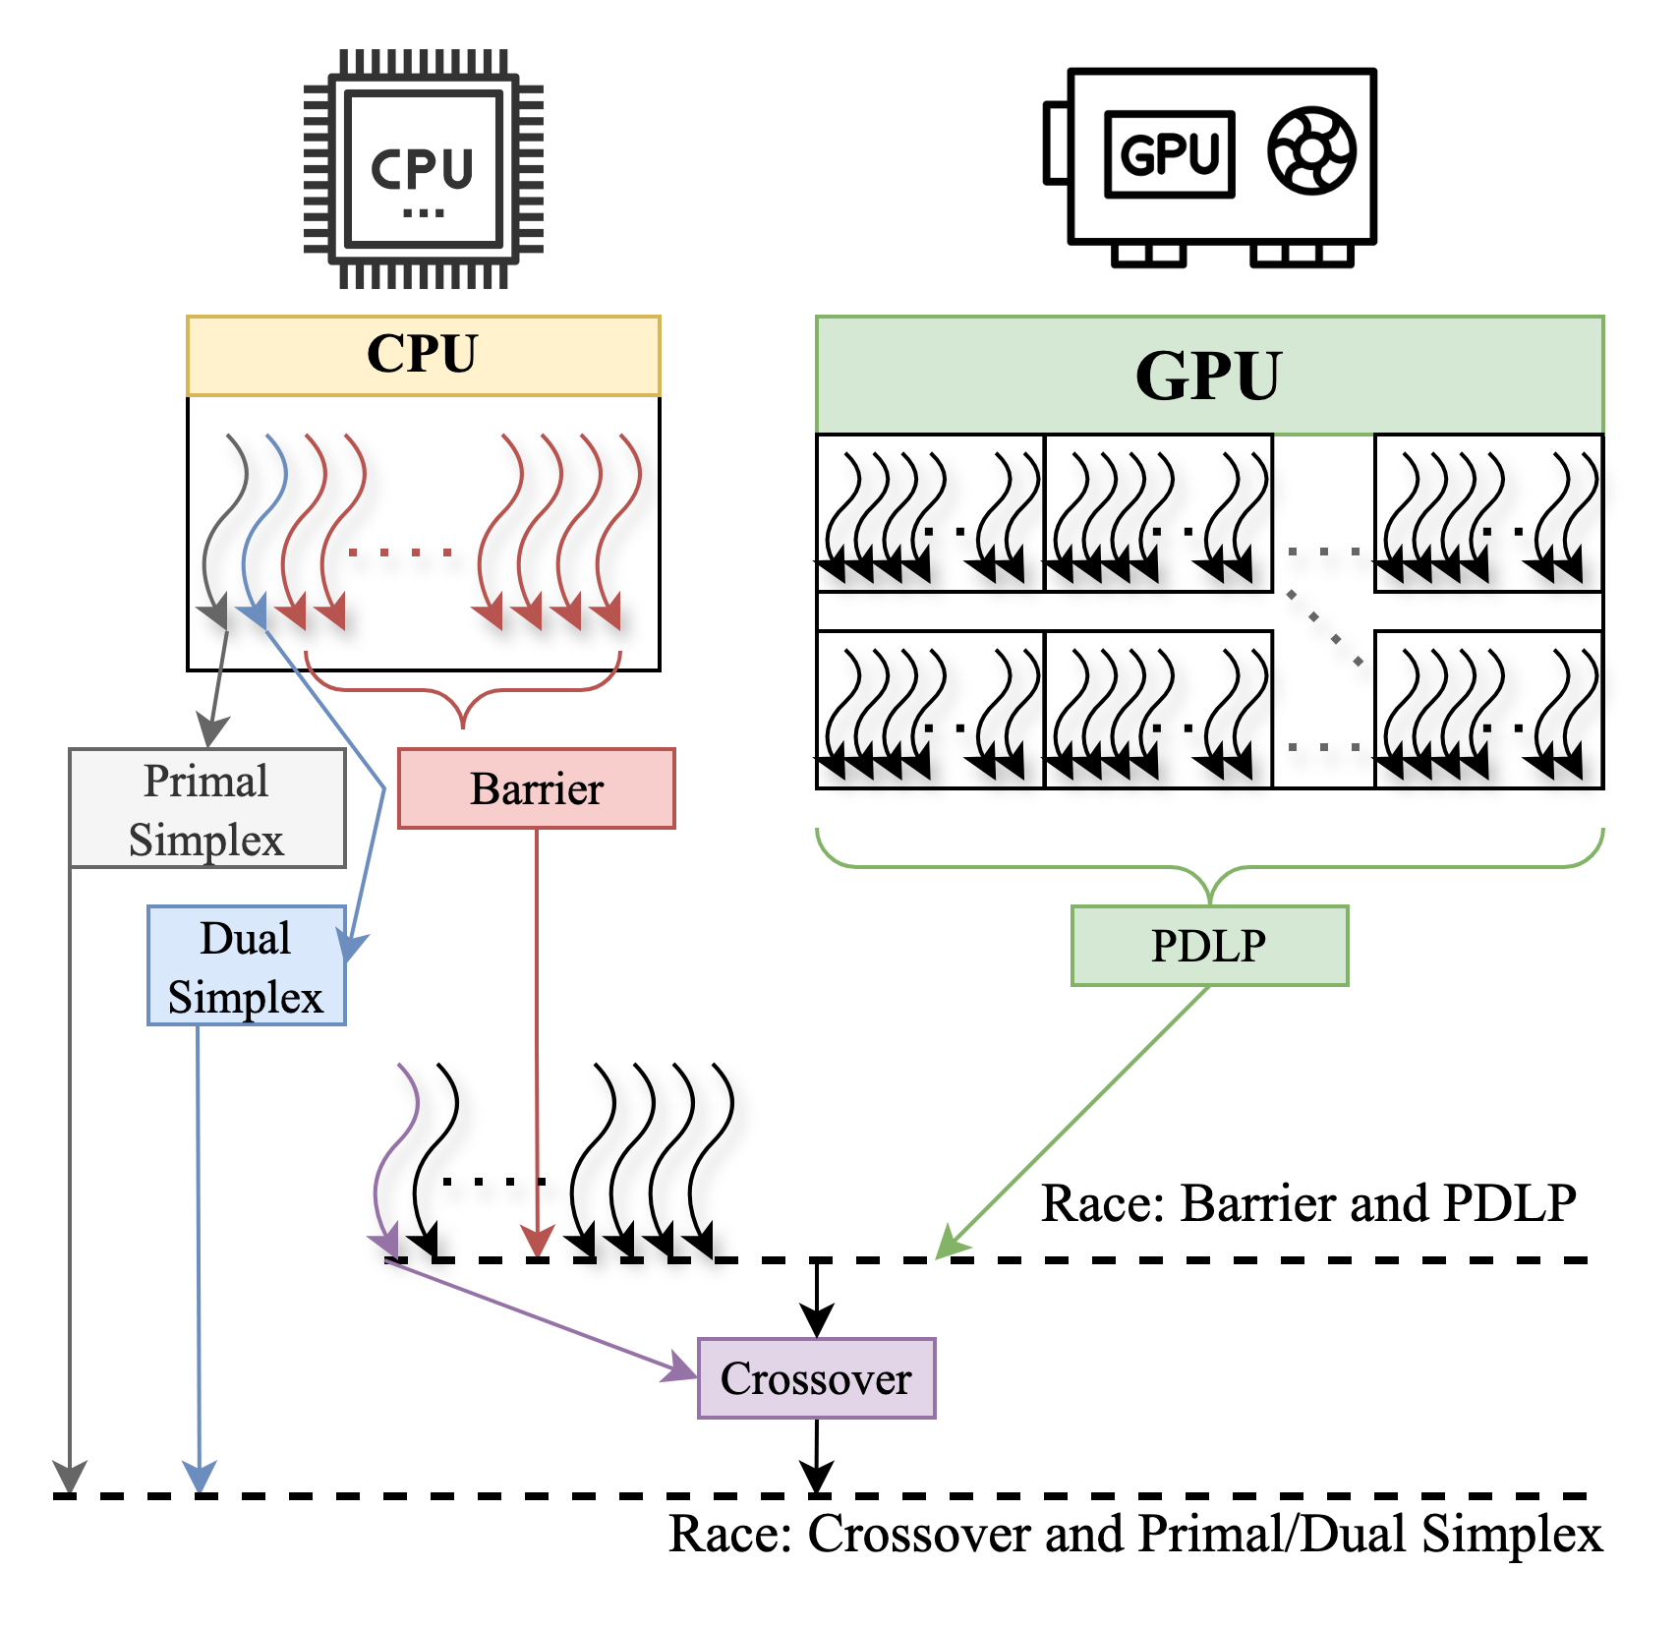
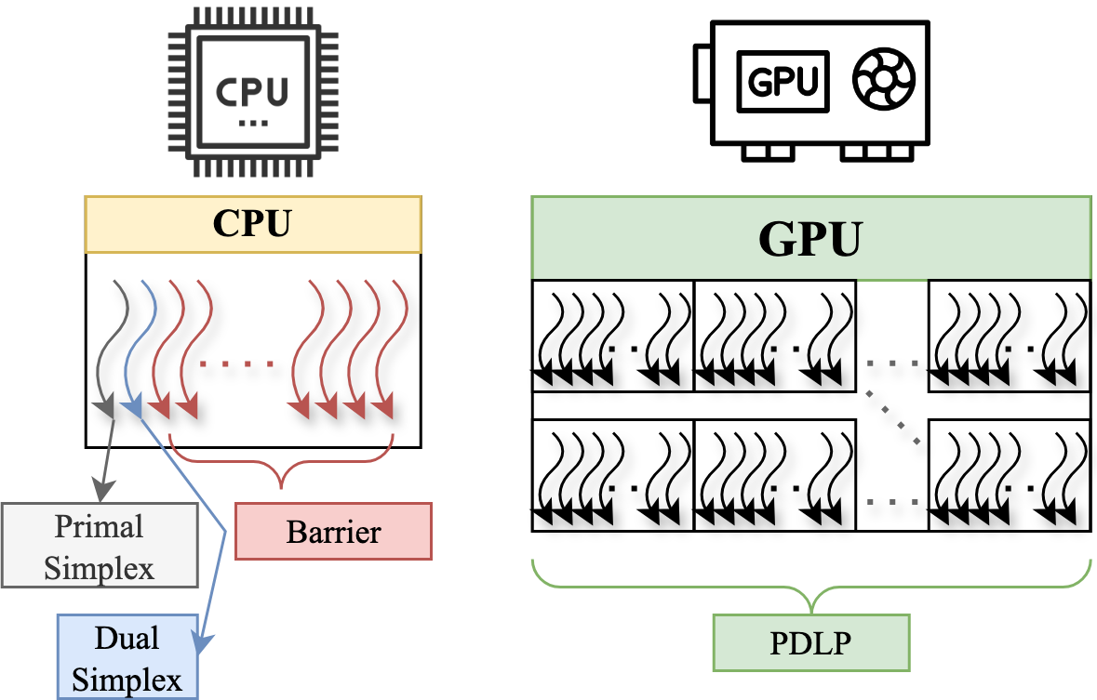
Crossover Algorithm - The New Bottleneck
Crossover algorithms give a corner point solution from an optimal* interior solution
*within tolerance
Root LP Pipeline on modern solvers
Poor Hardware
Utilization
Fraction of time spent in crossover algorithms for large-scale LPs
Source: Gurobi webinar “How to Exploit Parallelism in LP and MIP”

Slide 9
Traditional Crossover Algorithms
Traditional Crossover algorithms are sequential, typically simplex-based
Long sequential process
Iterate to optimal solution with simplex
Interior Point
Solution
ill conditioning?
Un-scale, Find slacks,
residuals, primals, duals
Basis selection
LU factorization
ill conditioning?
New PDHG inspired algorithm (Liu and Lu, September 2024)
Parallelizable
Fewer but expensive iterations
Interesting new direction for crossovers!
We improved the PDHG crossover algorithm

Slide 10
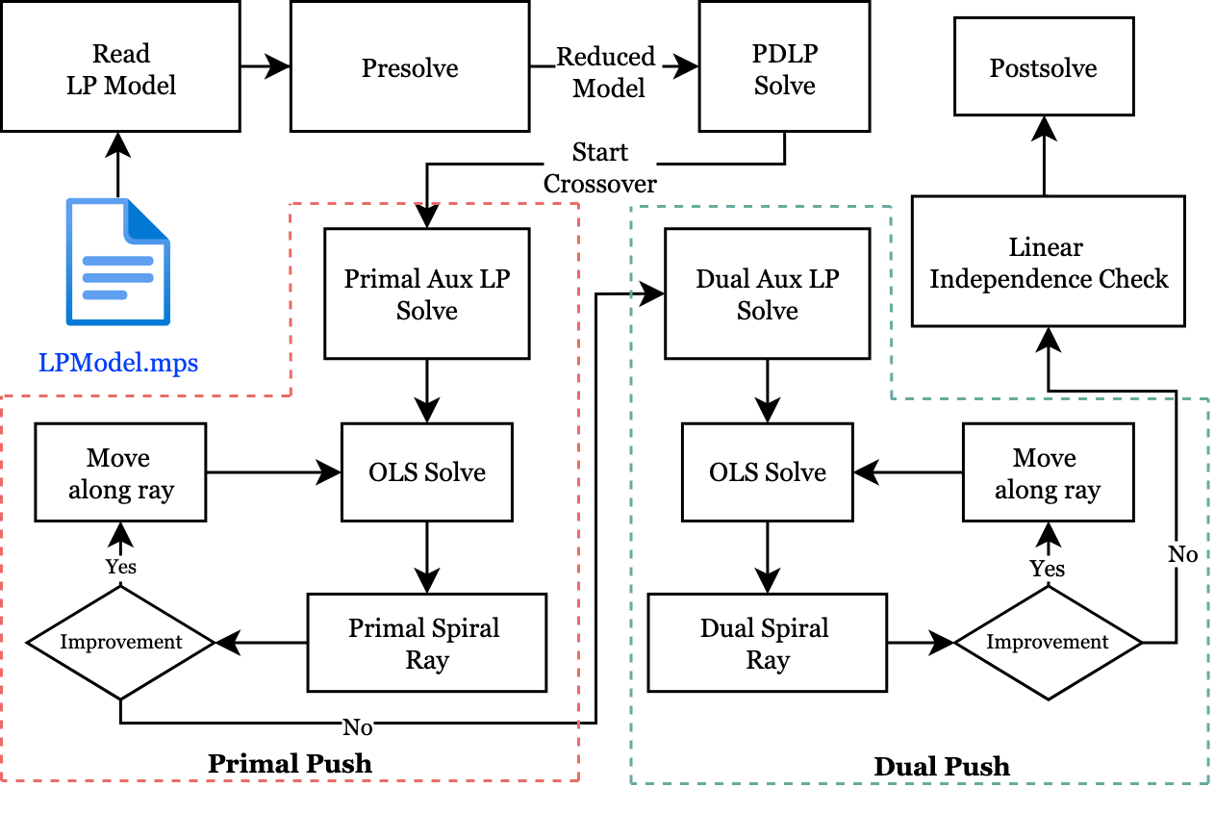
PDHG-Crossover Algorithm
Pros:
First parallelizable crossover algorithm
Significantly fewer iterations
Cons:
Needs 2 auxiliary LP solves
Primal/Dual pushes sometimes result in infeasibility and needs recovery
76 out of 100 NETLIB LPs succeed
Julia implementation from Liu and Lu 2024

Slide 11
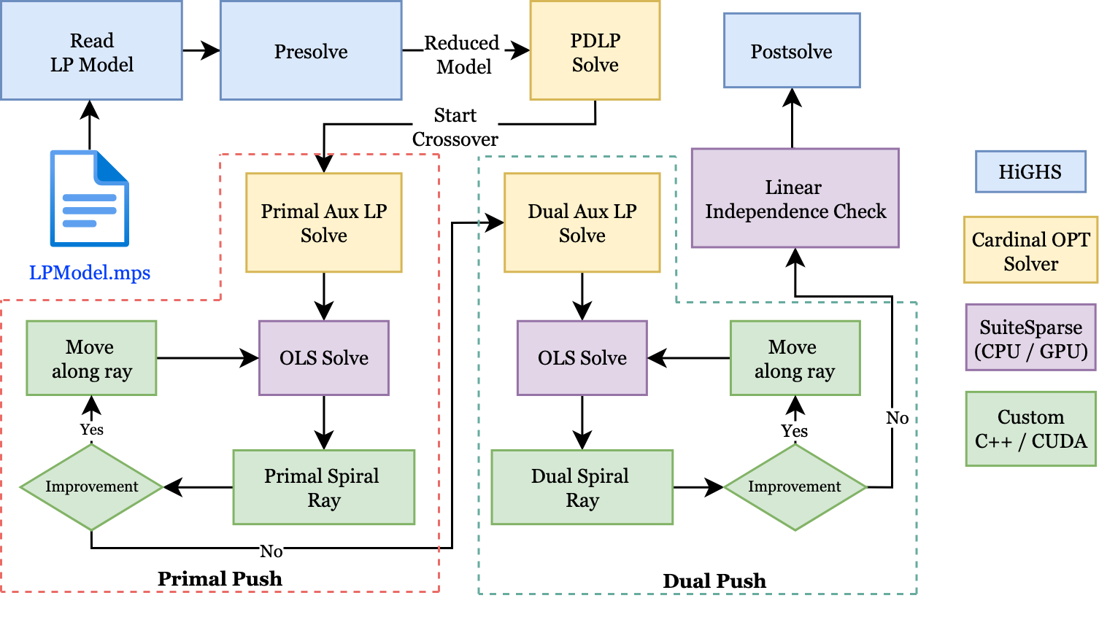
PDHG-Crossover Algorithm (Our Implementation)
C++ library for MILP
Commercial solver
Sparse Linear Algebra Library
Baseline for our improvements
Geomean 4.64x faster for NETLIB LPs
Overall bottleneck : Auxiliary LP solve
Key features: Sparse matrix storage and operations (Compressed Sparse Column)

Slide 12
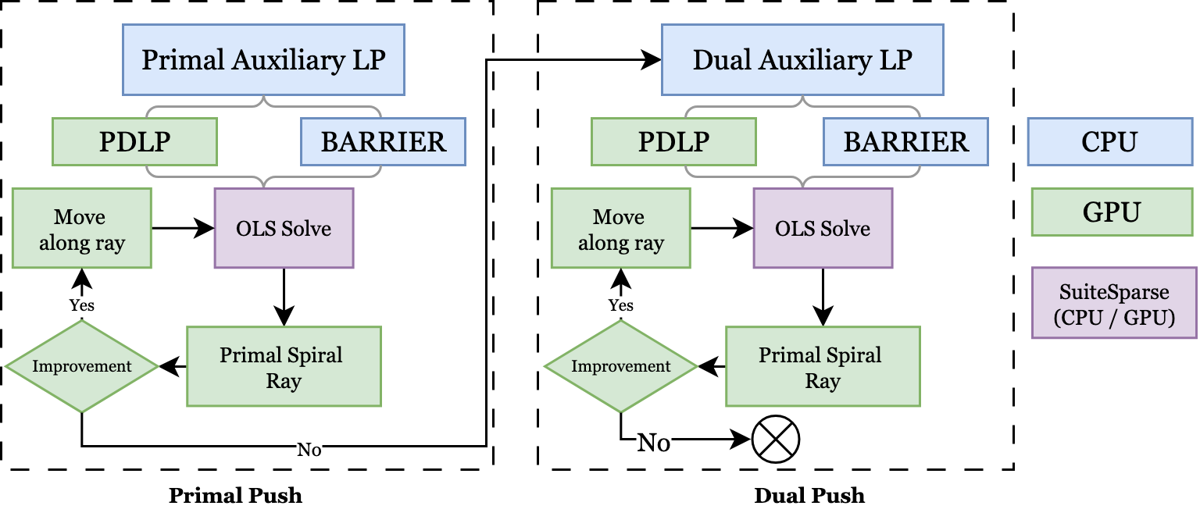
Improvement 1: Concurrent Aux solve
Original algorithm uses PDLP for auxiliary LP solve; unreliable performance
Race between:
Barrier and PDLP for auxiliary solves
PDLP: fast but unreliable
Barrier: slower but reliable
No Resource contention:
Barrier: On CPU with multithreading
PDLP: On GPU
Initial Basis selection based on winning method

Slide 13
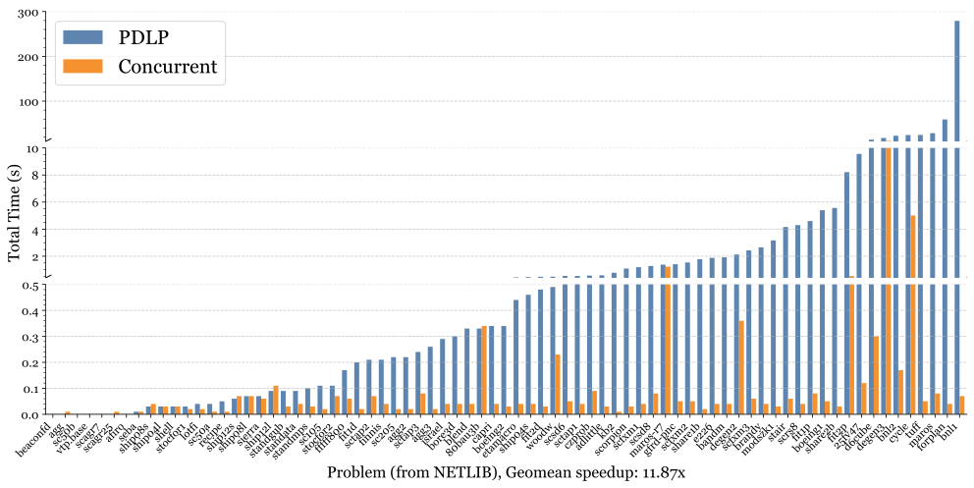
Improvement 1: Concurrent Aux solve --Impact
Geomean 11.87x faster over baseline for NETLIB LPs
Slowdown for some MIPLIB LPs

Slide 14
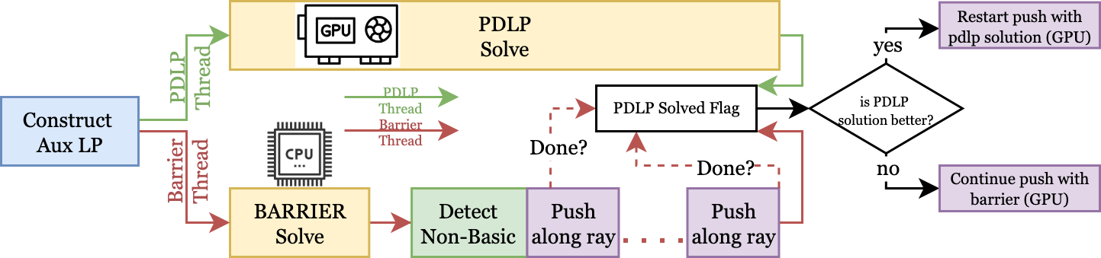
Improvement 2: Concurrent Aux solve with Adaptive Override
Concurrent Aux solve had slowdown for some large MIPLIB LPs
Reason: PDLP solution is typically sparser than Barrier solution
Solution: Override working solution from PDLP solve (if better)
Decide solution quality using pushes remaining

Slide 15
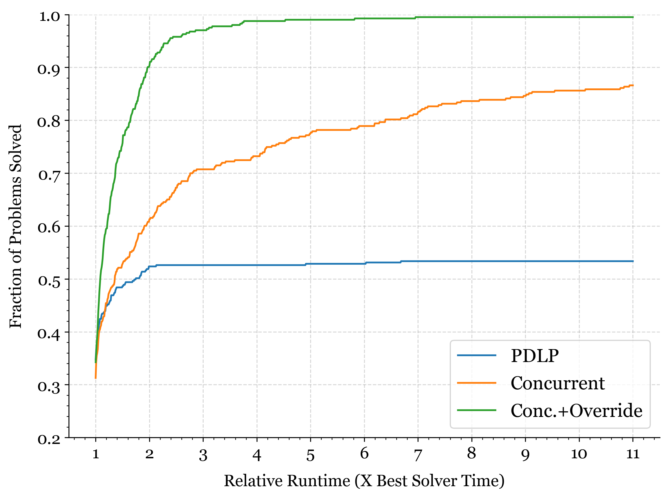
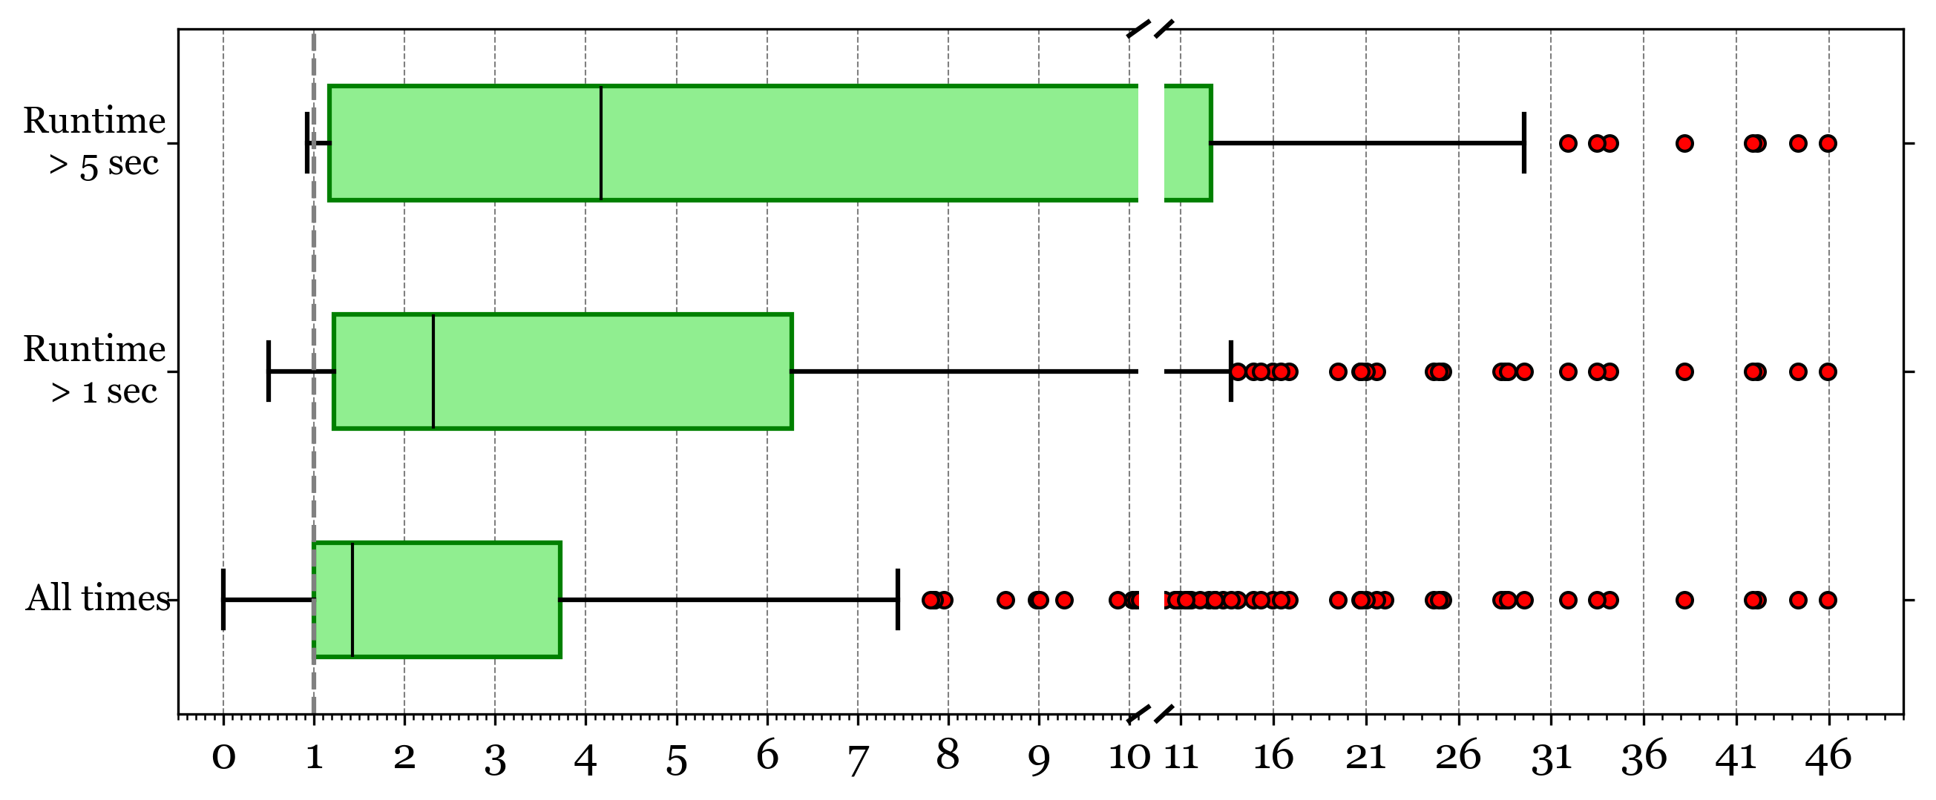
Improvement 2: Adaptive Override Impact
Adaptive override:
Improves performance and Robustness
Speedup Relative to baseline
New bottleneck: Iterative QR factorization
Performance profile over MIPLIB (Higher is Better)

Slide 16
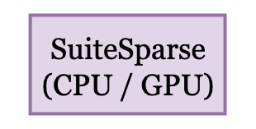
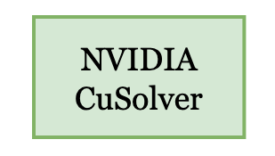
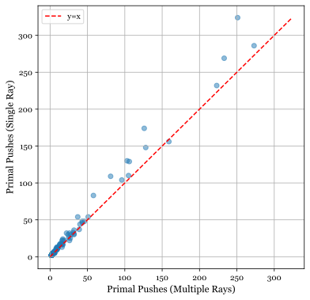
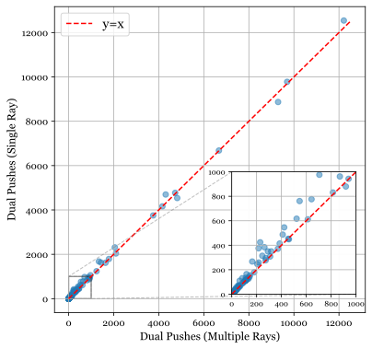
Improvement 3: Simultaneous Spiral Rays
Generate multiple rays with 2-phase OLS solve:
  QR factorization + Triangular system solve
+
Generate and dummy push on multiple rays
Greedily select the
best ray & push
Geomean Reductions (Over MIPLIB):
Primal Pushes: 1.24x
Dual Pushes: 1.07x
Time: 1.26x
Improved Robustness due to
avoiding infeasibility
Need slightly fewer primal and dual pushes

Slide 17
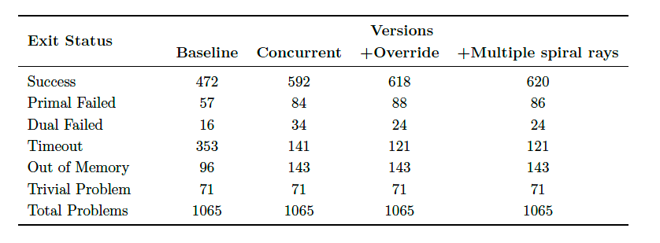
Robustness Improvements
More OOM cases
Barrier needs more memory
Successfully solve 13.9% more problems (from MIPLIB)

Slide 18
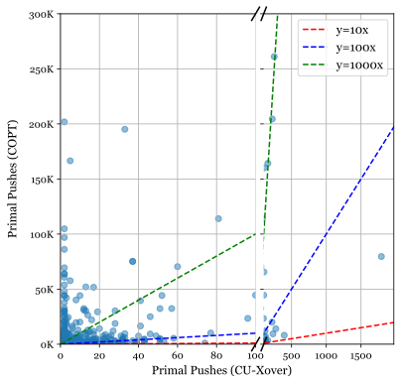
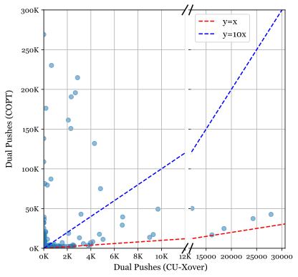
Comparison with COPT crossover
~600x fewer primal pushes
~16.3x fewer dual pushes
Significantly fewer pushes, but still ~25x slower

Slide 19
Summary
Significant reliability improvements (solves 148 more MIPLIB instances)
Significant Performance improvements
  > 50x (geomean) compared to Julia implementation for NETLIB LPs
  ~ 5x (geomean) compared to PDLP only baseline for MIPLIB LPs
~100x fewer iterations than traditional methods
Current bottleneck: Repeated QR factorizations.
  Need low-rank approximations for faster refactorizations.
  Warm starting PDLP can improve Aux LP solve performance
First parallel crossover solution with GPU acceleration

Slide 20

Questions ?
Thank You!

